Slide 1
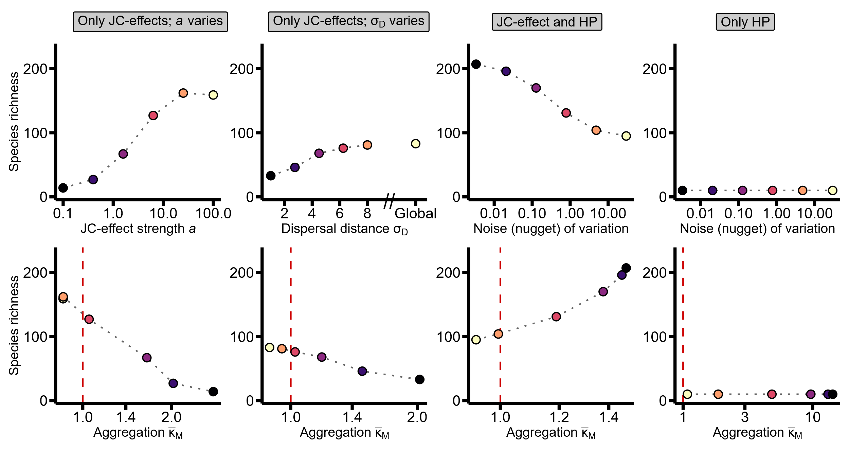
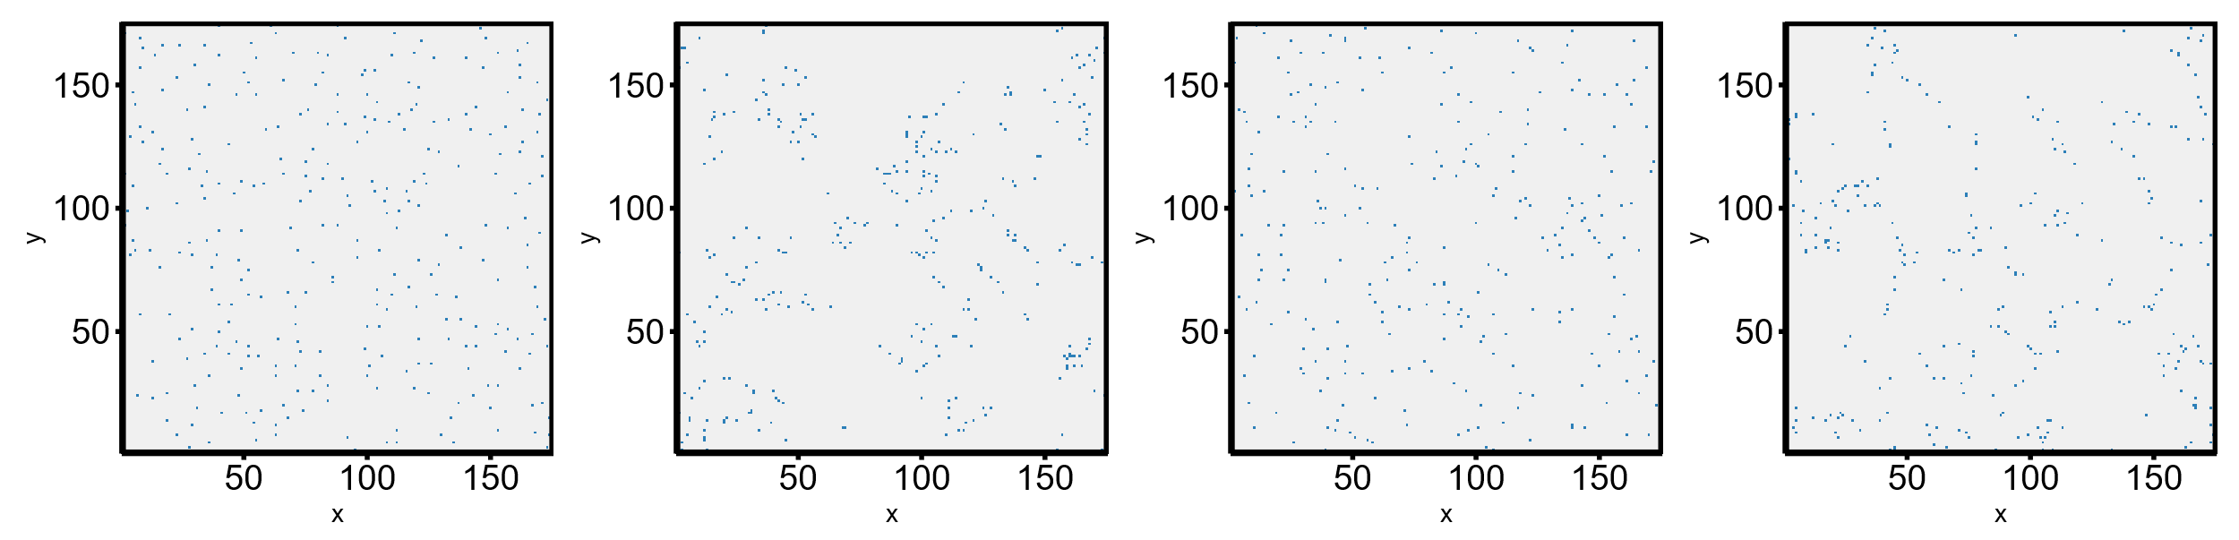
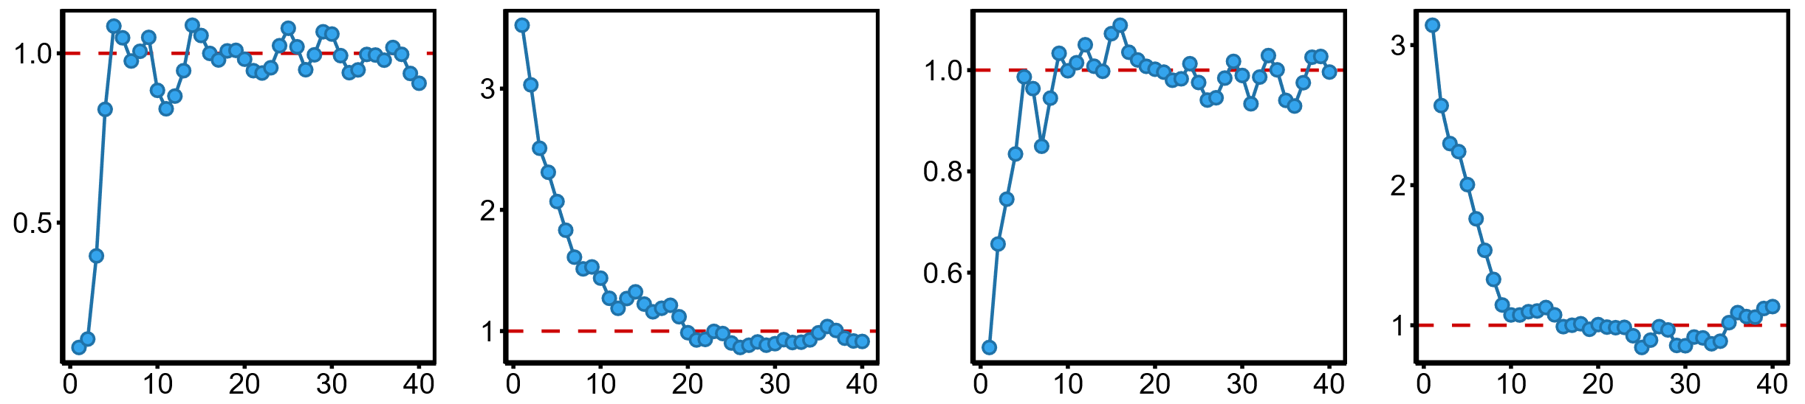
























A
$$a$$
B
C
D
E
$$a$$
G
H
F
L,P
I,M
J,N
K,O
I
$$a=100$$
J
$$a=0.5$$
K
$$a=0.5$$
L
$$a=0.5$$
$$σ_{D}=1.0$$
$$σ_{D}=2.75$$
$$σ_{D}=∞$$
$$σ_{D}=∞$$
$$Richness: 159$$
$$Richness: 43$$
$$Nugget=30$$
$$Nugget=0.01$$
$$Richness: 95$$
$$Richness: 207$$
$$x_{1}$$
c
$$x_{2}$$
$$x_{2}$$
$$x_{2}$$
$$x_{2}$$
M
N
O
P
$$g(r)$$
$r$ (in patch lengths)
$r$ (in patch lengths)
$r$ (in patch lengths)
$r$ (in patch lengths)

